Slide 1
AI-Based Network Intrusion Detection System
Made by Jai Rane
AICTE ID :STU6810aad0eabdb1745922768

Slide 2

PROBLEM STATEMENT
Organizations increasingly struggle to detect sophisticated and unknown cyberattacks using traditional rule-based intrusion detection systems.
High false-positive rates and limited adaptability reduce their effectiveness in real-time environments.
This project aims to address these challenges by developing an AI-based Network Intrusion Detection System capable of intelligent, adaptive, and accurate intrusion detection.

Slide 3

Project Description
This project focuses on the design and development of an AI-based Network Intrusion Detection System (NIDS) to enhance network security by identifying malicious activities in real time.
The system analyzes network traffic data and uses machine learning techniques to learn patterns of normal and abnormal behavior.
By continuously monitoring incoming and outgoing network packets, the system can detect potential intrusions such as unauthorized access, denial-of-service attacks, and other anomalous activities.
The AI-driven approach improves detection accuracy, adapts to evolving attack patterns, and reduces false positives compared to traditional rule-based systems.
This solution aims to support security teams by providing timely alerts and actionable insights for effective threat mitigation.

Slide 4

WHO ARE THE END USERS?
Security Analysts
SOC Teams
IT Administrators
Network Engineers
Enterprises & Organizations
Cloud Infrastructure Providers
Managed Security Service Providers (MSSPs)
Data Center Operations Teams

Slide 5

Technology Used
Programming Language: Python
Python Libraries used : Streamlit, Pandas, NumPy, Scikit-learn
AI model Deployement: Hugging Face
AI Inference API: Groq API
Code written Software: VS Code
Dataset Management: Microsoft Excel

Slide 6
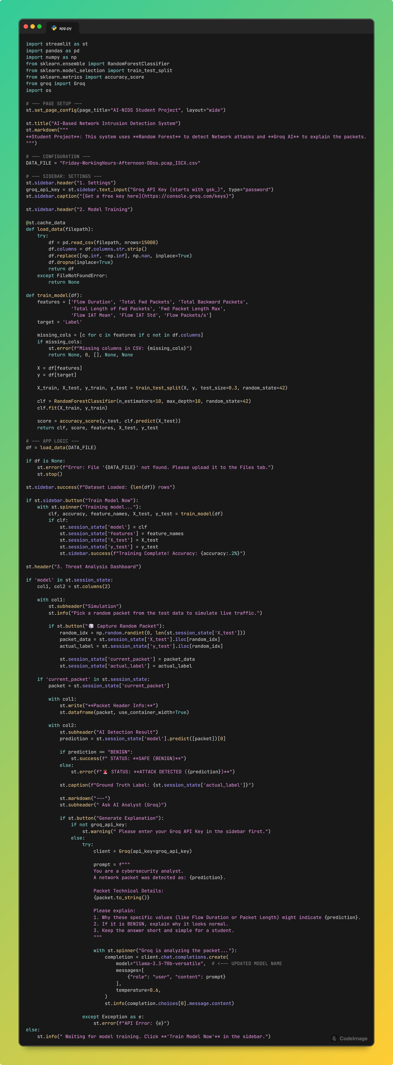
RESULTS
Python code Snippet 1

Slide 7
RESULTS
Python code Snippet 2

Slide 8
RESULTS
Python code Snippet 3

Slide 9
RESULTS
Python code Snippet 4

Slide 10
RESULTS
Python code Snippet 5

Slide 11
RESULTS
Python code Snippet 6/Final

Slide 12
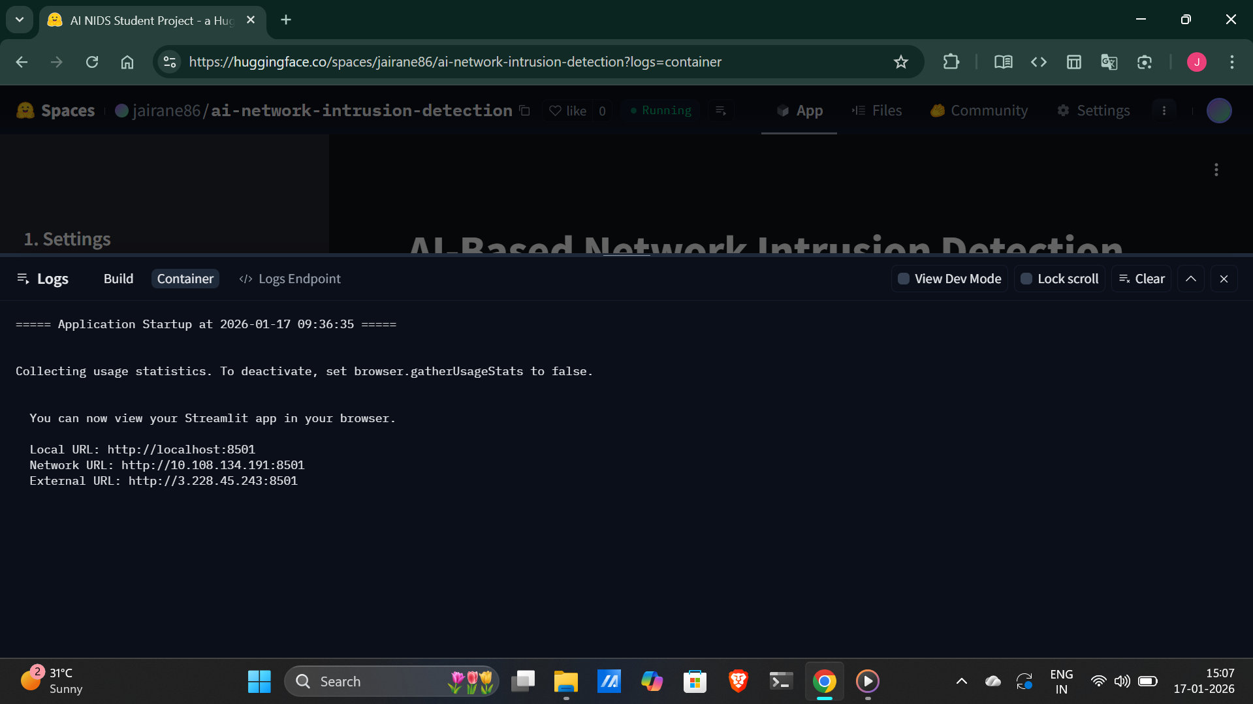
RESULTS
Output on Hugging Face deployed space Snippet 1

Slide 13
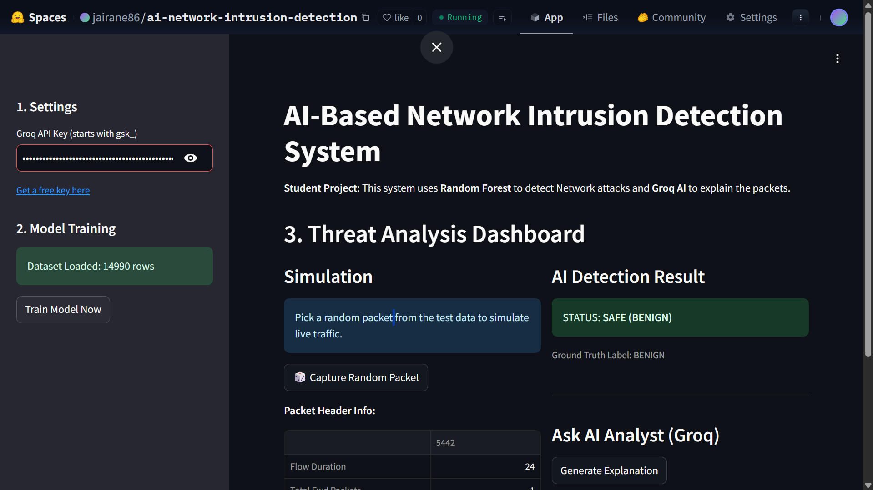
RESULTS
Output on Hugging Face deployed space with Groq API key Snippet 2

Slide 14
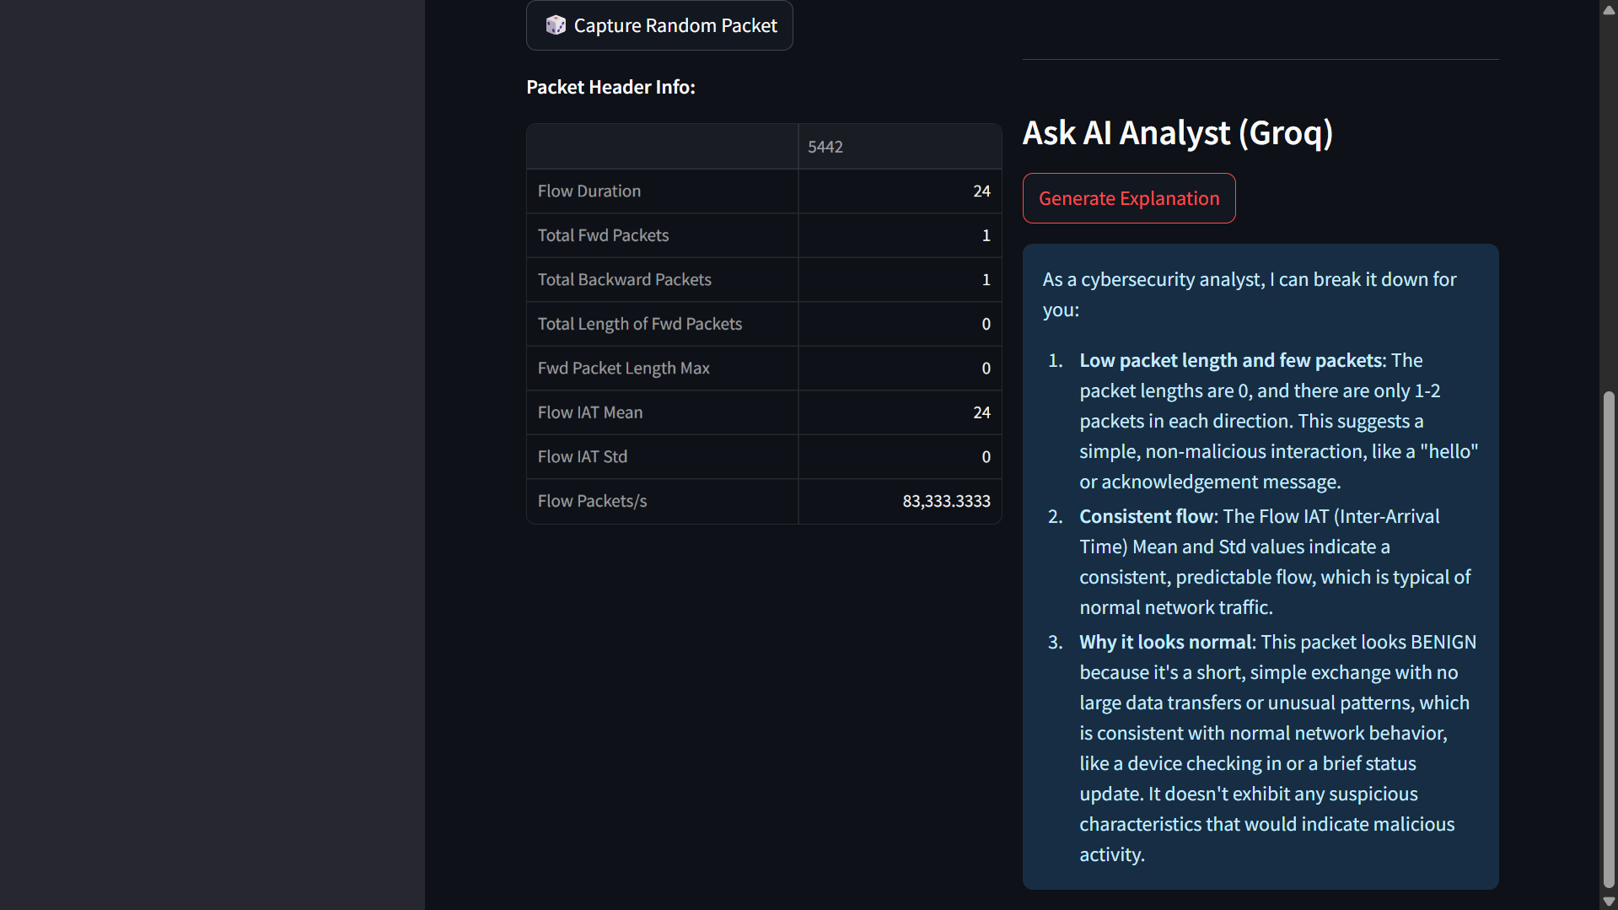
RESULTS
Output on Hugging Face deployed space Snippet 3

Slide 15

Certificate - Protection from browser attacks

Slide 16

Certificate - Introduction to System Security

Slide 17

Certificate - Securing Android Devices

Slide 18
GitHub link
Here is my GitHub Link as followed :
https://github.com/ranejai954/vois-cybersecurity-genai-internship/tree/main/build2

Slide 19
Thank you
.
.

